Slide 1
Software Testing and Quality Assurance
Haiming Liu
liuhaiming@bjtu.edu.cn
School of Software Engineering
Beijing Jiaotong University

Slide 2
Black-box Testing
Random Testing
Equivalence Partitioning
Boundary Value Analysis
Cause-Effect Analysis
Error Guessing
STATE TESTING

Slide 3
Cause-Effect Analysis
Cause-Effect Analysis is a systematic means for generating test cases to cover different combinations of input ‘‘Causes’’ resulting in output ‘‘Effects.’’
A CAUSE may be thought of as a distinct input condition, or an ‘‘equivalence class’’ of input conditions.
An EFFECT may be thought of as a distinct output condition, or a meaningful change in program state.
Causes and Effects are represented as Boolean variables and the logical relationships among them CAN (but need not) be represented as one or more boolean graphs.
Notes:
因果分析

Slide 4
Cause-Effect Analysis
Black-box technique to analyze combinations of input conditions
Identify causes and effects in specification ↓ ↓ inputs outputs current state new state
Make Boolean Graph linking causes and effects
Annotate impossible combinations of causes and effects
Develop decision table from graph with in each column a particular combination of inputs and outputs
Transform each column into test case

Slide 5
C-E Analysis Process Steps
Cause-effect analysis consists of the following 5 steps
Division of specification
Identification of cause and effects
Transforming the specifications into a cause-effect graph
Conversion into decision table:
Deriving test case

Slide 6
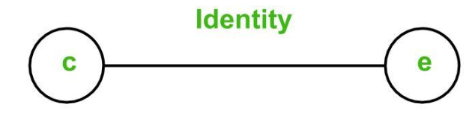
Basic Notations used in C-E Graph
Here c represents cause and e represents effect.
The following notations are always used between a cause and an effect:
Identity Function: if c is 1, then e is 1. Else e is 0.
Notes:
恒等

Slide 7
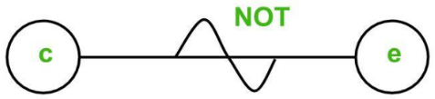
Basic Notations used in C-E Graph
NOT Function: if c is 1, then e is 0. Else e is 1.

Slide 8
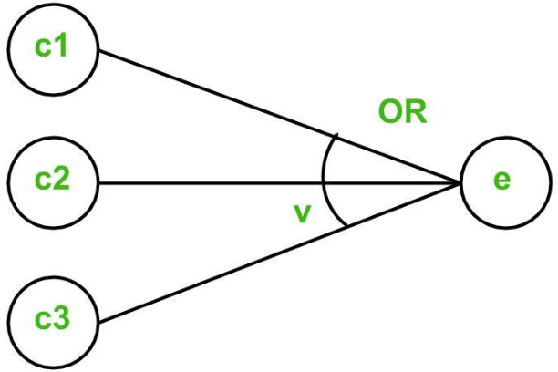
Basic Notations used in C-E Graph
OR Function: if c1 or c2 or c3 is 1, then e is 1. Else e is 0.

Slide 9
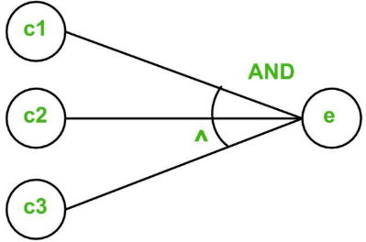
Basic Notations used in C-E Graph
AND Function: if both c1 and c2 and c3 is 1, then e is 1. Else e is 0.

Slide 10
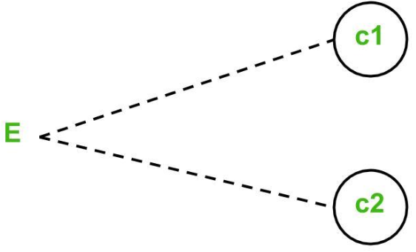
Basic Notations used in C-E Graph
To represent some impossible combinations of causes or impossible combinations of effects, constraints are used.
The following constraints are used in cause-effect graphs:
Exclusive constraint or E-constraint: This constraint exists between causes. It states that either c1 or c2 can be 1, i.e., c1 and c2 cannot be 1 simultaneously.

Slide 11
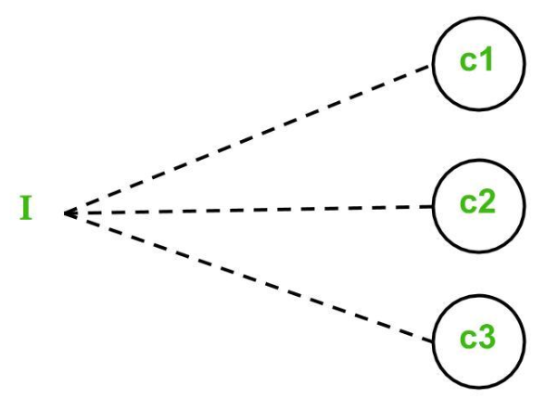
Basic Notations used in C-E Graph
Inclusive constraint or I-constraint: This constraint exists between causes. It states that atleast one of c1, c2 and c3 must always be 1, i.e., c1, c2 and c3 cannot be 0 simultaneously.

Slide 12
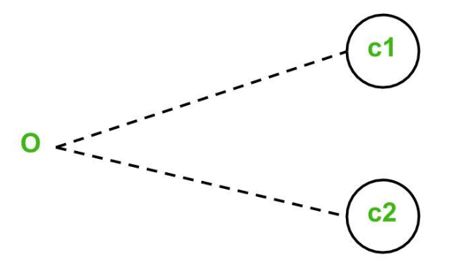
Basic Notations used in C-E Graph
One and Only One constraint or O-constraint: This constraint exists between causes. It states that one and only one of c1 and c2 must be 1.

Slide 13
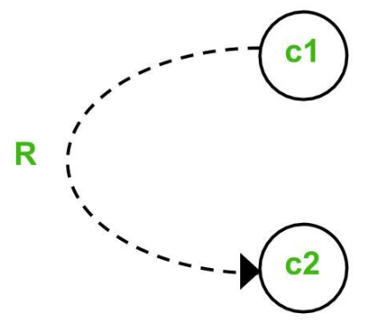
Basic Notations used in C-E Graph
Requires constraint or R-constraint: This constraint exists between causes. It states that for c1 to be 1, c2 must be 1. It is impossible for c1 to be 1 and c2 to be 0.

Slide 14
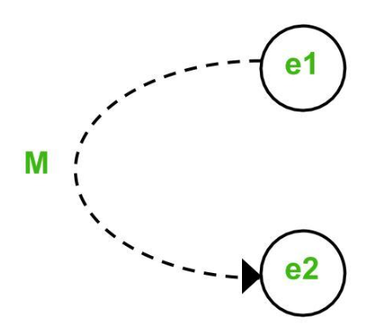
Basic Notations used in C-E Graph
Mask constraint or M-constraint: This constraint exists between effects. It states that if effect e1 is 1, the effect e2 is forced to be 0.

Slide 15
C-E Analysis
Mask constraint or M-constraint: This constraint exists between effects. It states that if effect e1 is 1, the effect e2 is forced to be 0.

Slide 16
Cause-Effect Analysis Sample
产品说明书：有一个处理单价为1元5角钱的盒装饮料的自动售货机软件。若投入1元5角硬币，按下“可乐”、“咖啡”、或“茶”按钮，相应的饮料就送出来。若投入的是2元硬币，在送出饮料的同时退还5角硬币。
Cause-effect analysis consists of the following 5 steps
Division of specification
Identification of cause and effects
Transforming the specifications into a cause-effect graph
Conversion into decision table:
Deriving test case

Slide 17
Deriving test case

Slide 18

主观题
Equivalence Partitioning
10分
产品说明书：当输入第一列字符必须是X或Y，第二列字符必须是数字时，对文件进行修改，如果第一列字符不正确，则给出信息A，如果第二列字符不正确，则给出信息B。
1.请列出因果关系
2.画因果图
3.判定表
4.生成测试用例
作答

Slide 19
Black-box Testing
Random Testing
Equivalence Partitioning
Boundary Value Analysis
Cause-Effect Analysis
Error Guessing
STATE TESTING

Slide 20
Error Guessing
Testers utilize intuition and experience to identify potential errors and design test cases to reveal them.
Guidelines:
Design tests for reasonable but incorrect assumptions that may have been made by developers.
Design tests to detect errors in handling special situations or cases.
Design tests to explore unexpected or unusual program use or environmental scenarios.

Slide 21
Error Guessing
Examples of conditions to explore:
(1) Repeated instances or occurrences
(2) Blanks or null characters in strings (etc.)
(3) Negative numbers
(4) Non-numeric values in numeric fields
(5) Inputs that are too long or two short Using intuition and experience, identify tests you would

Slide 22
Error Guessing
Just ‘guess’ where the errors are ……
Intuition and experience of tester
Strategy:
Make a list of possible errors or error-prone situations ( often related to boundary conditions )
Write test cases based on this list

Slide 23
Error Guessing
More sophisticated ‘error guessing’: Risk Analysis
Try to identify critical parts of program ( high risk code sections ):
parts with unclear specifications
developed by junior programmer while his wife was pregnant ……
complex code : measure code complexity - tools available (Logiscope,…)
High-risk code will be more thoroughly tested ( or be rewritten immediately ……)

Slide 24
STATE TESTING
All software flows from one state to another.
For some software, these state changes are obvious:
Paint Program
To determine states, we need to build a state transition diagram or state transition map.
Good requirements or specifications often include these.
There are software tools for drawing them.
Different diagramming techniques exist --- we’ll use just one, but it is not the only one possible.

Slide 25
Definition: State Transition Map
A STM is a graph showing the logic flow from state to state in the program. This is diagrammed using the symbols:
a state
the start state
a transition
All of these are labeled
States- to identify them
Transitions- to identify what triggers movement from one state to another state.

Slide 26
Example of Part of STM
Display dialog box
Correct username & password entered
idle
Press Ctrl/Alt/ Delete
Incorrect username or password entered
Click OK
Display error message
Obviously, these can become quite large!!

Slide 27
Example of Part of STM
客户向航空公司打电话预定机票，此时机票信息处于“预订”状态；顾客支付了机票费用后，机票信息变为“已支付”状态；旅行当天到达机场，拿到机票后，机票信息变为“已出票”状态；登机检票后，机票信息变为“已使用”状态；在登机之前任何时间都可以取消自己的订票信息，如果已经支付了机票的费用，则还可以退款，取消后，订票信息处于“已取消”状态；

Slide 28
What the STM Shows
Each unique state of the software.
Input or condition needed to move from one state to the next.
What is set or what output is produced when a state is entered or exited.
Obviously, we can’t investigate all possible paths through the state transition map (this is really the “traveling salesperson problem”).
Notes:
。

Slide 29
Use Equivalence Partitioning to Choose Test Cases for State Testing
Possible choices for partitioning:
Try to visit each state at least once.
Test the most common or popular state-to-state transitions.
Test the least common paths between states.
Test all entrances and exits from error states.
Test random state transitions --- i.e. throw darts a the transition state map!
All of these are testing-to-pass cases.

Slide 30
More on State Testing
Involves checking all state variables which define a state.
It is suggest that checking with the spec writers and programmers to identify possible states --- but, caution
DO NOT GO TO THE CODE LEVEL!
Programmers will tend to want to drag out code if it exists!

Slide 31
Testing-to-Fail State Testing
Check race conditions – a timing problem causes the execution to not proceed as planned.
Try interrupting the program in the middle of its execution as see what happens.
Is data lost?
Can the program be restarted in a clean condition?
Start two instances of the same program and input to both.
What happens?

Slide 32
Repetition, Stress & Load Testing
Repetition testing can often find memory leaks --- memory not freed completely when it should be.
Stress testing tries to run under bad conditions --- low memory, slow CPU, etc.
Load testing overloads the program with huge data files, long periods of execution, etc.
Round all of this out by just playing like a dumb user! (But, call them an inexperienced user, please!)
Notes:
重复测试经常会发现内存泄漏——内存在应该释放的时候没有完全释放。不断地执行同一个操作，不停地启动和关闭操作，还可以反复读写和反复选择同一个动作，可能几个重复或是上前或是上万次操作发现缺陷。可能刚开始运行良好，时间长了之后就不行了。
压迫测试试图在坏的条件下运行——内存不足、CPU速度慢等。将支持限定在最低程度，在不够理想地状态下运行，有点想边界测试了。
负载测试用大量的数据文件、长时间的执行等使程序过载。与压迫测试相反，尽可能地提供条件，工期发挥，让他测试尽可能大地数据，最大程度地挖掘其能力。
通过像一个愚蠢的用户一样玩游戏来解决这一切！（但是，请称他们为没有经验的用户！）

Slide 33
Which One to Choose?
Black-box testing techniques :
Equivalence partitioning
Boundary value analysis
Cause-effect analysis
Error guessing
…………
Test derivation from formal specification, Which one to use ?
None of them is complete
All are based on some kind of heuristics
They are complementary
Notes:
黑盒测试技术：
等价划分
边值分析
因果图
错误猜测法…………
从正式规范派生的测试，使用哪一个？
没有一个是完整的
所有这些都是基于某种启发法
它们是互补的

Slide 34
Which One to Choose?
Always use a combination of techniques
When a formal specification is available try to use it
Identify valid and invalid input equivalence classes
Identify output equivalence classes
Apply boundary value analysis on valid equivalence classes
Guess about possible errors
Cause-effect graphing for linking inputs and outputs
Notes:
一定要综合运用各种技巧当
一个正式的规范可用时，试着使用它
识别有效和无效的输入等价类
识别输出等价类
在有效等价类上应用边值分析
猜测可能的错误
连接输入和输出的因果图

Slide 35
To be continued… See you next week

